Slide 1



学位论文答辩
Dissertation defense
Fake News Propagation and Detection: A Sequential Model
涂世龙
时间：3.7

Slide 2
目录
CONTENTS
The Agents’ News-Sharing Process
The Platform’s Inspection Problem
01
Introduction
02
A Model of Fake News
03
04
The Impact of Fake News on Agent Opinions
05
06
Discussion

Slide 3
01
Introduction

Slide 4
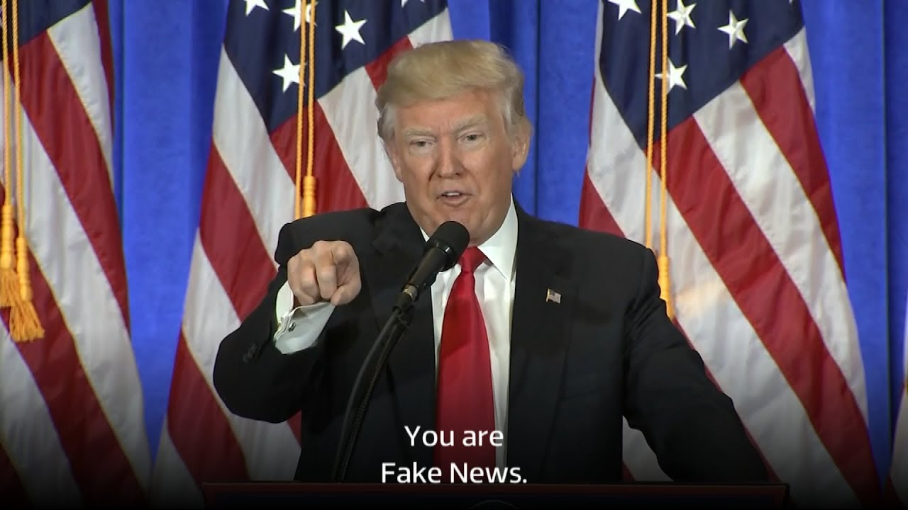

“Pope Francis Shocks World, Endorses Donald Trump for President”
“ISIS Leader Calls for American Muslim Voters to Support Hillary Clinton”

Slide 5
How we do this
Step 4
Step 3
Consider the implications of this policy for the agents’ learning environment
Quantify the expected impact of a news article on the agents’ beliefs as a function of the article’s validity
Study the platform’s optimal inspection policy
Step 1
Step 2
Establish the platform’s optimal inspection policy in the presence of fake news

Slide 6
02
A Model of Fake News

Slide 7




a binary state of the world: θ ∈{T, C}
the state realization that the information contained in the article supports: m ∈{“T”, “C”}
the persuasiveness of the information when this is taken at face value: a ∈(0.5, 1)
The contents of an article are fully described by the observable pair: (m, a)

Slide 8
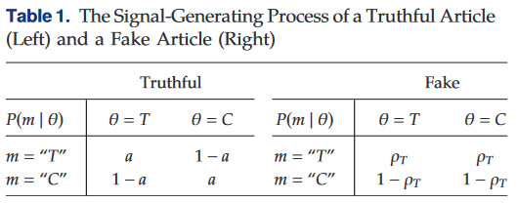
Example 1
“UC Berkeley study finds no connection between climate change and the burning of fossil fuels.”
θ ∈{Y, N}
(m, a)(“N”, 0.95)

Slide 9


Distinguishes between truthful and fake news
All articles are truthful
Update people’s prior belief b via Bayes’ rule to b′
All articles are fake
Updates people’s belief via Bayes’ rule to

Slide 10
The Agents’ News-Sharing Process
03
Develop a sequential model of news propagation among a population of rational agents

Slide 11
Process Description
An infinite number of agents receive articles in discreate time t ∈{1, 2, ...}
Agents have their own prior belief to θ ∈{T, C} (that the underlying state is T)
The validity of article is represented by v ∈{t, f } (true and fake)
For an article of validity v, the agent’s utility gain from a sharing action s ∈{0, 1}. (do not share and share)
For a truthful article, share makes a bigger u. A fake one is on the contrary.

Slide 12
Process Description
Do not share, Article dies
The article is exogenously shared with a randomly chosen agent
whether to “inspect” (i.e., fact-check) the article to determine its validity
whether to share the article or not
Share, Repeat process

Slide 13

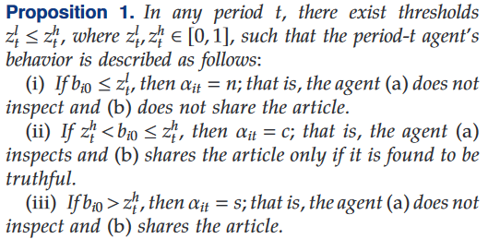
Analysis
Action set
An agent whose prior opinion is more strongly aligned with the article’s content will rationally perceive the article as less likely to be fake.

Slide 14
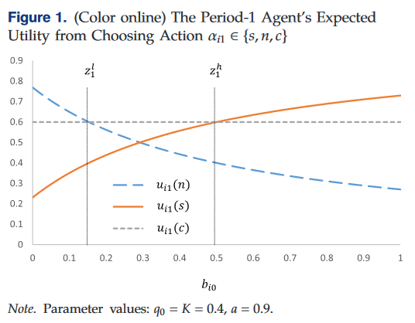
Analysis
Action set
n representing not sharing without inspecting
n representing not sharing without inspecting
c representing inspecting (i.e., fact-checking) the article and subsequently deciding (correctly) whether to share it or not
articles type: m =“T”

Slide 15

Analysis
For an article to be received by the period-t agent, this means that the article has been shared t − 1 times in the past, and the more the article has been shared, the less likely it is that its content is fabricated.
The thresholds described in Proposition 1 are nonincreasing in time

Slide 16
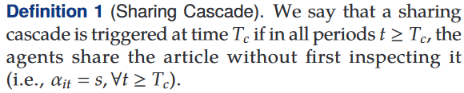
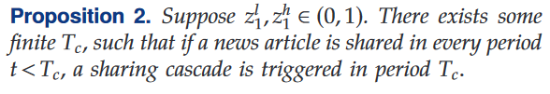
Analysis
means
If an article survives for a critical number of periods T_c, it is subsequently shared by the agents in perpetuity.

Slide 17
04
The Platform’s Inspection Problem

Slide 18
Problem Descriptions
Truthful, shared in perpetuity
Inspect
For a platform:
Collects a reward r if an article is shared in period t (i.e., irrespective of whether the article is true
Incurs a penalty p if the article being shared is fake.
The later is bigger than the former
Platform want to maximize its profit
Platform’s prior belief is the average believes of agents
Fake, discontinued
Platform
Do not Inspect
Agent decide whether to inspect

Slide 19

Problem Descriptions
System state can be denoted as:
The former implies that the article has survived up until period t
The later means either:
sharing of the article has been discontinued by the agents
or the article has been inspected by the platform and its validity disclosed

Slide 20
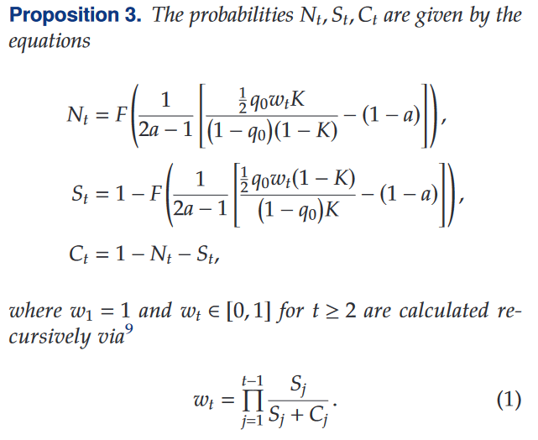

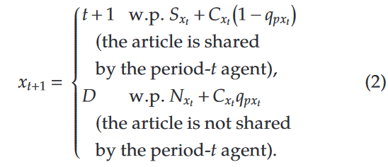
Problem Descriptions
For articles that the platform has inspected:
For articles that the platform has not inspected:

Slide 21

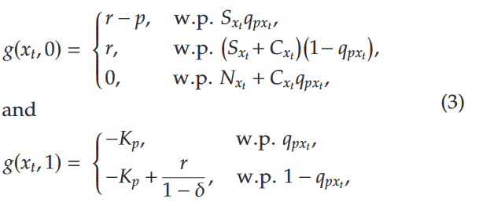
Problem Descriptions
The total expected discounted reward

Slide 22
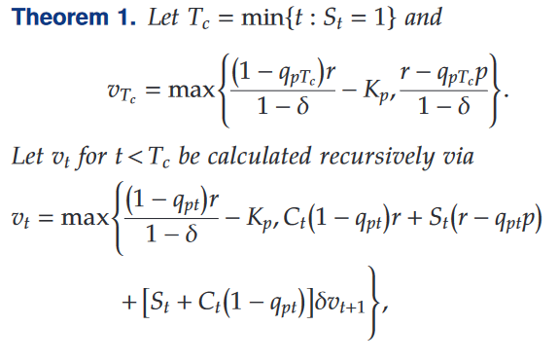
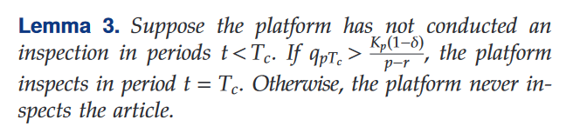
Analysis
Assuming the platform has not taken action up until the period in which a cascade is triggered, Lemma 3 suggests that it then makes an immediate once-and-for-all decision.

Slide 23
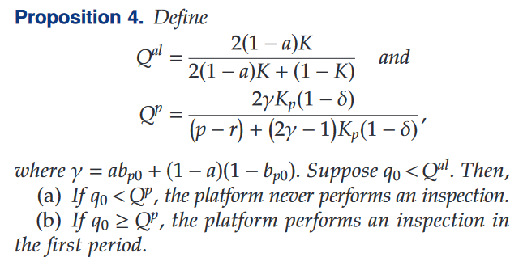
Analysis
We first consider cases where the agents’ news-sharing process, in the absence of any platform intervention, is highly susceptible to the propagation of fake news. These are described in the following proposition.

Slide 24
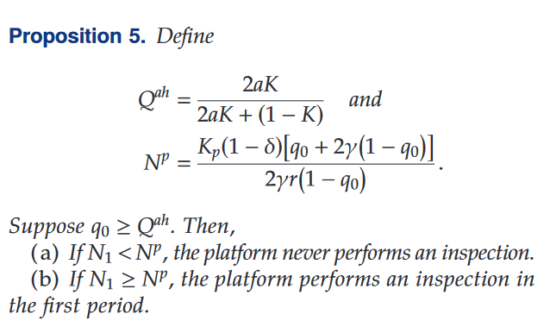
Analysis
The other extreme, where the agents’ news-sharing process is highly robust to the propagation of fake news.

Slide 25
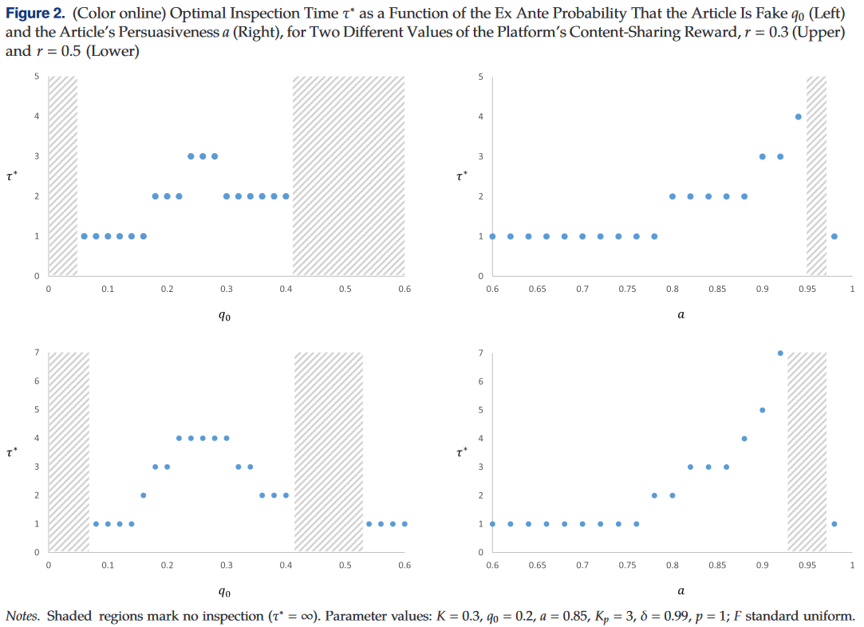
Analysis

Slide 26
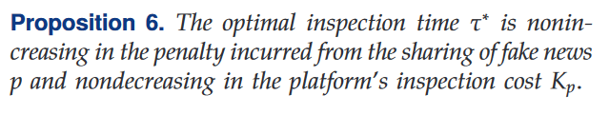
Analysis
Intuition
The higher the platform’s penalty from the sharing of fake news, the earlier the platform opts to conduct an inspection;
The higher the platform’s inspection cost, the more it prefers to delay its inspection.

Slide 27
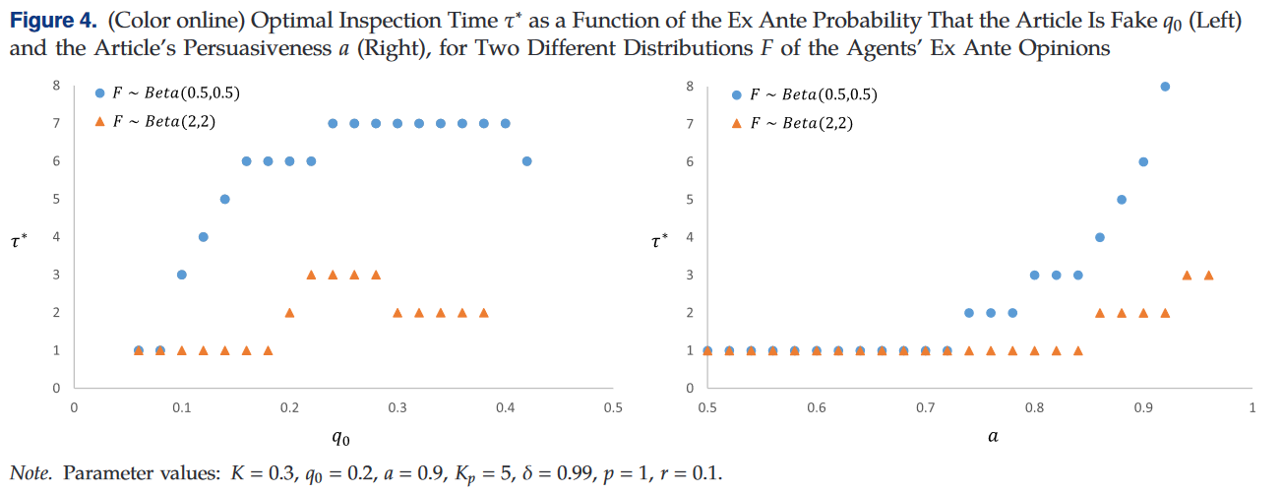
Conclusion
Depending on the article’s topic, agents may be more or less polarized in their ex ante opinions, and it is of interest to understand how this affects the platform’s approach to conducting content inspections.

Slide 28
The Impact of Fake News on Agent Opinions
05
Turn our attention to the potential of fake news to sway the agents’ opinions

Slide 29
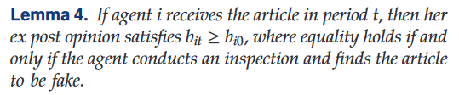
the prior opinion b_{i0} captures the agent’s ex ante belief that the state is θ = T and that our analysis focuses on articles whose message is m = “T”
The only way for the positive influence to be neutralized is if the agent conducts an inspection and concludes with certainty that the article is fake.
Analysis

Slide 30
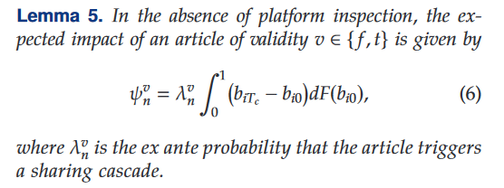
Analysis
When there is no platform inspection. In this case, the impact of a news article can be calculated as:
The article’s average impact is dominated by the shift in opinions it causes once a cascade is triggered

Slide 31
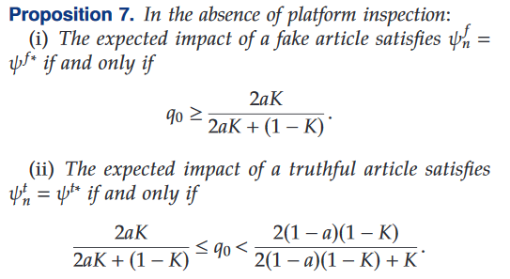
Analysis
The direct effect, which refers to the propagation of fake news
The indirect effect, which refers to the impact of fake news on the propagation of truthful articles

Slide 32
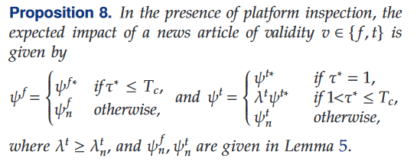
Analysis
The asymmetric nature of the platform’s inspection policy with respect to combating the direct and indirect effects of fake news

Slide 33
06
Discussion

Slide 34



Further concern
One significant aspect of the fake-news phenomenon that is not explored in our model is the process by which fake news is generated.
Conclusion 3
The incentives that lead to the platform’s policy being more effective depend to a great extent on the characteristics of the news environment.
Conclusion 2
When the ex ante probability is very low, the platform should not conduct an inspection; when it is moderately low, the platform should conduct an inspection from the onset of the sharing process; when it is moderate, the platform should conduct a delayed inspection; and when it is high, the platform should either conduct an inspection from the onset or no inspection at all.
Conclusion 1
In the absence of any platform intervention, fake news articles are likely to proliferate through sequential sharing, even when agents are intent on sharing only truthful articles.

Slide 35
学位论文答辩
Dissertation defense
Fake News Propagation and Detection: A Sequential Model
THANK YOU
涂世龙
时间：3.7

